Slide 1

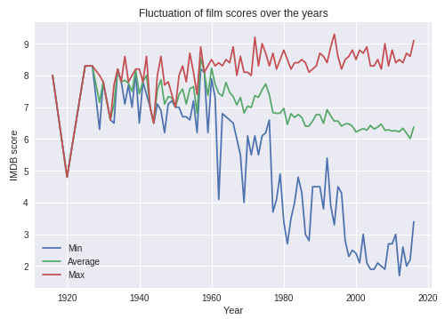



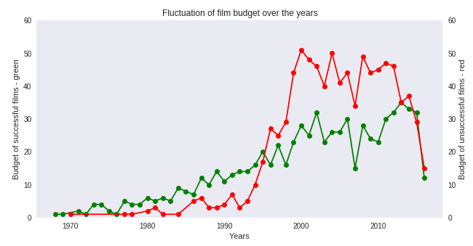
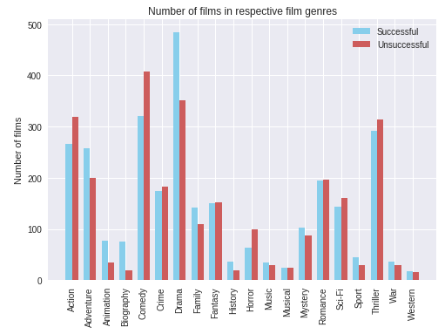
Analysis of successful vs
unsuccessful films
M. Romaniuk
1
For the first part, I did a regular exploratory analysis of the IMDB 5000 movie dataset to better understand the data I was dealing with and to determine the points based on which I would separate successful from unsuccessful films.
For the second and main part, having determined which films are normally
considered successful and which are not, I started analysing the dataset to see what role things like budget, film duration, film genre or film director play in the film’s success.
2
To get a (roughly) even number of films on both sides, I decided that each film that has a score of 6.4 and above is well-rated, and everything below 6.4 is not. Out of the ones that are a 6.4 and higher I only took films that grossed at least $30m because everything below that could well be considered niche, whereas I am interested in more or less mainstream films, and that additionally I decided that successful films made more money than was their budget. Unsuccessful were less than 6.4 and made less than the company spent making them.
Exploring connections between duration and score, gross and score, and duration and gross revealed the following: there is not much correlation between duration and IMDB score (although yes, longer movies appear to be more highly rated but also there are much less of them as a whole), but highly rated (>=6.4 IMDB score) films are shown to make a good amount of money, whereas the results among poorly rated films vary greatly. One more outtake is that films with below-average and average duration tend to make more money than the especially long ones.
I compared the budget of successful vs unsuccessful films to see whether how much it cost to make a film actually had any influence on the success of the movie. And no, it did not. Furthermore, in the last 20 years unsuccessful films have turned out to be more expensive. Sure, part of that is because my initial criteria for an unsuccessful film was that the studio spent more than it earned, but also since all of the unsuccessful films are first and foremost poorly rated, the outtake of this is that the studios throw away money making poor quality
productions that do not even appeal to viewers.
3
As for genres, adventure, animation, biography, drama, history, family and sport films tend to be more successful than action, comedy and horror films (and the rest are not much different), even though there is still nothing critically different.
Analysing director data, one can tell that some directors are more likely to create a successful movie than the others, although many directors who have quite a few films might not actually have any successful ones. Also apparently the biggest number of successful films was made a few years ago, and the biggest number of unsuccessful films was made in the early 2000s.
Having gotten so much information from the movie dataset, there is still not one clear thing that influences film success. It seems it must be a combination of a large amount of factors, at least one of which has to be pure luck. As it is, this research still manages to provide an answer (albeit perhaps an unsatisfying one). What makes a film successful? Apparently, we just don’t know. And neither do the studios making those films.
Conclusions
Applied Sciences Faculty, Ukrainian Catholic University, Lviv, Ukraine (romaniuk@ucu.edu.ua)

